Slide 1

Data Science Project
Problem Statement Title: Estimation of Obesity levels based on Eating Habits and Condition
Mentor’s Name- Ms. Shanu Sharma Team Member’s Name- Shivam Gupta, Rishav Chourasia
Roll Number- 2000320100159,2000320100137

Slide 2
Problem Statement
Motivation - The estimation of obesity levels based on eating habits and physical conditions is an important area of research as obesity is a major public health concern worldwide.
Project Objective – The ultimate objective of this problem statement is to develop a tool that can help individuals and healthcare professionals to better understand and address the issue of obesity.
Scope of the Project - From collecting a large amount of already labeled data in order to make a proper medical machine learning model helps the medical fraternity lower their burden.

Slide 3
Idea Details
Obesity is a growing concern in modern society, and it has been linked to various health issues such as heart disease, diabetes, and certain types of cancer. One way to tackle this issue is to develop effective methods for estimating obesity levels in individuals, based on their eating habits and physical condition
Eating Habits and Physical Conditions are the factors to develop a model that can accurately estimate obesity levels
A patient needs to revisit the clinic often to track the progress of the disease over time.
The productive screening process does not demand a medical visit and can be more helpful.
To classify the people who are healthy and people who are suffering from Obesity through ML-based methods/algorithms.

Slide 4
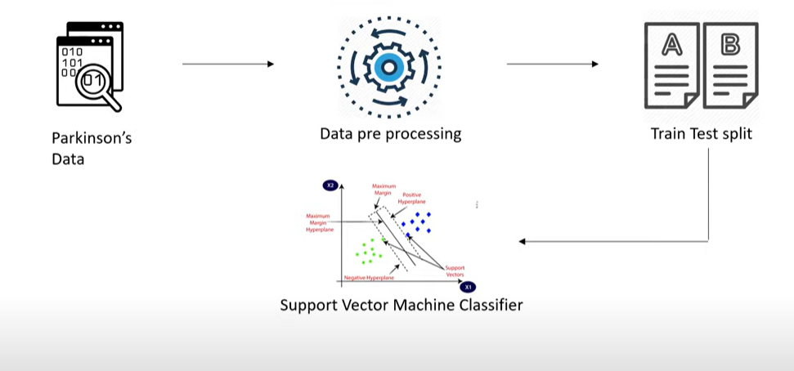
Pictorial Reprsentation

Slide 5
Methodology
A dataset should be collected that includes information on various factors such as age, gender, daily caloric intake, type of food consumed, physical activity level, and BMI.
The collected data should be cleaned and preprocessed to remove any inconsistencies or missing values.
Feature selection involves identifying the most relevant features that contribute to the prediction of obesity levels. This can be done using techniques such as correlation analysis, and feature importance scores.
The selected features can then be used to train a machine learning model using regression analysis, classification analysis, decision tree, and clustering analysis techniques.

Slide 6
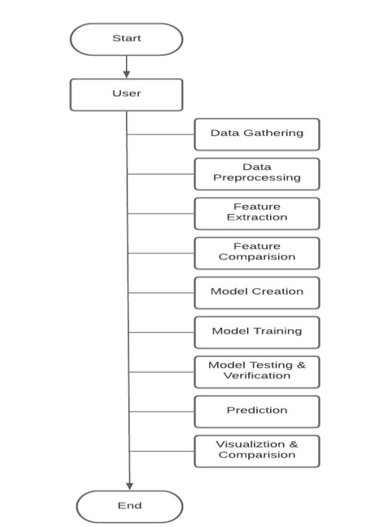
Working of Algorithm

Slide 7
Benefits of the project:-
Medical Fraternity- The burden of medical professionals can be minimized, as this will help in prioritizing the patients.
Policymakers- Policymakers can do suitable policies for the proper flow of funds for the maintenance and working of medical institutions for Parkinson’s disease. It can also help in assigning the appropriate funds for infrastructure
People having symptoms of Obesity - Knowing the severity of symptoms in less time will reduce the panic among the stakeholders

Slide 8
References
Palechor, F. M., & de la Hoz Manotas, A. (2019). Dataset for estimation of obesity levels based on eating habits and physical condition in individuals from Colombia, Peru and Mexico. Data in brief, 25, 104344.
Kivrak, M. (2021). Deep learning-based prediction of obesity levels according to eating habits and physical condition. The Journal of Cognitive Systems, 6(1), 24-27.
Quiroz, J. P. S. (2022). Estimation of obesity levels based on dietary habits and condition physical using computational intelligence. Informatics in Medicine Unlocked, 29, 100901.
Cui, T., Chen, Y., Wang, J., Deng, H., & Huang, Y. (2021, May). Estimation of Obesity levels based on Decision trees. In 2021 International Symposium on Artificial Intelligence and its Application on Media (ISAIAM) (pp. 160-165). IEEE.
Yagin, F. H., Gülü, M., Gormez, Y., Castañeda-Babarro, A., Colak, C., Greco, G., ... & Cataldi, S. (2023). Estimation of Obesity Levels with a Trained Neural Network Approach optimized by the Bayesian Technique. Applied Sciences, 13(6), 3875.
Celik, Y., Guney, S., & Dengiz, B. (2021, July). Obesity Level Estimation based on Machine Learning Methods and Artificial Neural Networks. In 2021 44th International Conference on Telecommunications and Signal Processing (TSP) (pp. 329-332). IEEE.

Slide 9
THANK YOU

